Slide 1
Dementia Navigators
Judy Carole
Dementia Navigator
Dorking and South Mole Valley

Slide 2
Benefits and Care Support for People with Dementia

Slide 3
Role of the Dementia Navigator
19 Part time Dementia Navigators across Surrey
Funded by Surrey County Council
Navigates the person with dementia and their carer from diagnosis to full time care
Helps maintain their independence and control over their lives
1:1 information and support for carers and people with dementia so they maintain independence at home

Slide 4
Through:
Support groups for people with dementia
Support groups for carers and families
Guidance around benefits
On going practical and emotional support

Slide 5
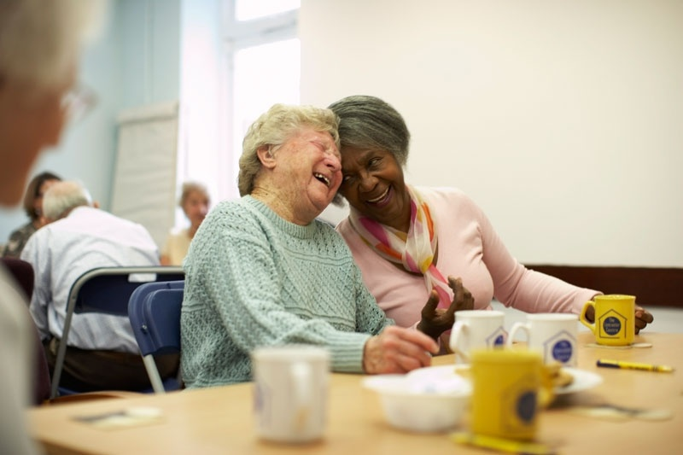
What we offer in Surrey
Singing for the Brain
Carer Information Service
Support Groups for Carers
Day Centres
Dementia Cafes
Walking Group
Training
Notes:
For over 30,000 people a week

Slide 6
What is Available?

Slide 7
Attendance Allowance
When the disability is severe enough to need help in caring for yourself or need someone to supervise. Not means tested, not taxed
Weekly Higher rate £77.45
Weekly Lower rate £51.85
http://www.direct.gov.uk/en/MoneyTaxAndBenefits/BenefitsTaxCreditsAndOtherSupport/index.htm

Slide 8
Council Tax Disregard
Eligible for a Council Tax reduction of 25% if living with another adult or
100% disregard if they live alone
Need a doctor's certificate states they're severely mentally impaired and entitled to Disability Living Allowance or Attendance Allowance
http://www.direct.gov.uk/en/HomeAndCommunity/YourlocalcouncilandCouncilTax

Slide 9
Blue Badge
Eligible for a Blue Badge if receiving the Higher Rate Disability Living Allowance but if only in receipt of Attendance Allowance have to prove there is a problem with mobility
http://www.direct.gov.uk/en/disabledpeople/motoringandtransport/dg_4001061

Slide 10
Carer’s Allowance
Aged 16 or over
Spend at least 35 hours a week caring for someone who is ill or disabled
The cared for needs to be in receipt of an Attendance Allowance or Disability Living Allowance at the middle or highest rate for personal care
http://www.direct.gov.uk/en/CaringForSomeone/MoneyMatters/CarersAllowance/index.htm

Slide 11
Social Services Referral
A referral to Social services for an appropriate assessment (care or financial)
Will be either sent by post
Or face to face depending on the circumstances of recipient

Slide 12
Self Funding
If over the financial threshold, clients are classed as self funding
Although they are still entitled to a social care assessment
Referral to Domiciliary Care Agencies
Crossroads

Slide 13
Early Intervention and Prevention

Slide 14
Social Services One Off Payment
Social Services able to give up to £1000 one off payment on an annual basis, after carer’s assessment, for the carer to assist in supporting the person with dementia

Slide 15
GP Carers Break
GP carer breaks payment NHS funded
GP has to make the decision that having a break would benefit the carer’s health
Break in a broad sense of the word - can be used to buy a computer
Up to £500 not means tested once a year
SILC appropriate the money
www.gpcarersinfo.co.uk

Slide 16
Carer’s Support Fund
Funded through the local carer support group. For those not eligible for social services involvement for whatever reason, but are desperate to get support
Up to £500
Fund made available through SILC
http://www.surreyilc.org.uk/direct_payments/what_are_direct_payments/

Slide 17
Disabilities Facilities Grant
This is a grant that can be used to give better freedom of movement in and around the home and/or to provide essential facilities within it.
http://www.direct.gov.uk/en/DisabledPeople/HomeAndHousingOptions/YourHome

Slide 18
Telecare
A range of equipment designed to assist vulnerable people to live more independently by monitoring safety around the home. For example:
Community alarm
Bed sensors
Gas detector
Fall detector
http://www.surreytelecare.com/

